Slide 1
System Design Fundamentals
2021, Algo Export
Yang Xi’s Reading Note

Slide 2
Introduction to Design Fundamentals
Type of system to built, functionalities to support by the system, characteristics to value the system
Four broad categories
Foundational Design Knowledge
minimal needed knowledge to begin anything, such as client-server model, network protocols
Key Characteristics of Systems
Things to you want a system to have, or to trade-off, such as availability, wait-and-see, throughput, redundancy, consistency
Actual Components of a System
More tangible things you have / implement in a system, such as load balancers, proxies, caches, rate limiting, leader election
Tech
Existing product / services which you can actually use in a system, either as actual components, or to achieve a certain characteristic, such as Zookeeper, XCD, Engine X, Reddits, Amazon S3

Slide 3
Client-Server Model
Client: something speaks to a Server
“speak to” means “send data to” or “request data from”
Client doesn’t know what the server is; it only knows that it can be communicated with.
It needs to request info from the server, and do stuff based on what is returned
For example, your browser is a client. To visit a website
It first needs to make a DNS query to find out the IP
Then it sends a HTTP request to the IP
The request also contains the IP of the client (source address), so the server knows where to response to
Server: something listens to clients, or listens for clients to speak to it, and then it speaks back to the clients
A server usually listens for requests on specific ports (one of the 16000 ports)
The client has to specify the port to communicate on, usually depend on protocol
HTTP is 80; HTTPS is 443 – something decided long-time ago
Continue from the above “visiting website example”. A website usually has many servers.
After getting the request, the server responses with the HTML of the website
The client’s browser renders the HTML to show on the screen.

Slide 4
Network Protocols
Protocol: an agreed-upon set of rules for an interaction between two parties
Consists of type, format, order and required response of messages
Popular network protocols
IP (Internet Protocol): modern internet effectively runs on IP
IP Packet: fundamental unit of data, made up by bytes, with two main sections
IP header: at the beginning, contains source & destination IP addresses, total size, version of IP (v4 / v6)
Data: a single packet is very small, only about 2^16 bytes
Challenge: How to handle missing packets, incorrect order, etc when sending sequence of packets?
TCP (Transmission Control Protocol): built on top of IP to resolve the challenges
Transmit packets in an ordered, reliable and error-free way.
You will know when a packet is missed / corrupted, and when you need to resend
Use in all web application, and it allows to send arbitrarily long pieces of data
With additional TCP header: contains the order of packets
Handshake: A special TCP interaction where machine A sends a packet to B, then B responses to A, lastly A response to B to confirm.
If no packets after specific period – time out
Still lacks a robust framework to define meaningful and easy to use communication channels
HTTP (next page)

Slide 5
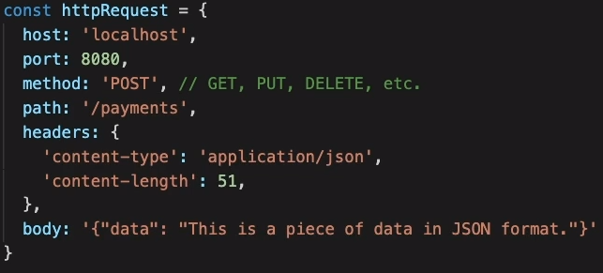
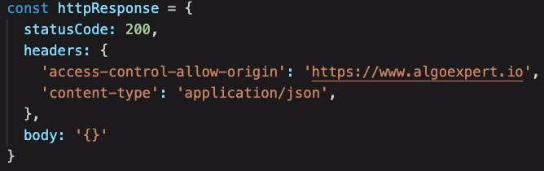
Network Protocols
Popular network protocols
HTTP (HyperText Transfer Protocol): build on top of TCP
Request-Response-Paradigm: a higher level of abstraction above TCP
Machine A sends a request to B, B response to A
With a set of rules, this makes it easy for developers to create robust and easy to maintain systems
Developers don’t need to handle packets, but only HTTP requests and responses
Common fields in the request:
host, port
method (post / get / put / delete / etc): purpose of the request
path
headers: meta data
body: thedata
Common fields in the response:
statusCode: describe the type of response
headers
Body
HTTP is more than just transmitting data
Add business logic (path and endpoints) into development

